Slide 1

Info-Kiosk
Celestial Orca
Philip Bedward Daniel Cox Matthew Dunn Aaron Liu
Notes:
Hello we are celestial Orca
And today we will be presenting our progres on Info-kiosk
A project given by our sponsors, biz cloud experts

Slide 2
Our Sponsor
Bizcloud Experts
AWS Solutions Provider based in Lewisville, TX
Architecture and Advisory
Operations Management
IOT Solutions Implementation
Nagesh Kunamneni - CEO and main point of contact
Small team of developers
Notes:
Bizcloud experts is a aws solutions provider based out of lewisvillle texas
AWS solutions providers create cloud solutions for other companies and organizations to adopt
Bizcloud specializes in the architect and advisory of cloud services
They provide consulting for companies who want to migrate to aws
Management of operations for applications deployed on the cloud
Creates iot solutions for companies who want to delve into that space
Mention Nagesh and the Team (Two lead developers supporting us)
Sponsor and main contact
Given a small team to provide domain knowledge and expertise

Slide 3
Agenda
Overview of Info-Kiosk
Requirements and Architecture
Process Methodologies
Plan
Metrics
Risks
Design Choices
Lessons Learned and Future Plans
Questions

Slide 4
What is Info-Kiosk

Slide 5
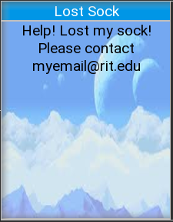
Info-Kiosk
A Smart TV-driven electronic bulletin system
Displays important information to an audience
Lost and found notices
Safety alerts
Event updates
Targets all types of enterprises (Universities, Businesses, etc.)
Allows anyone in the organization to contribute
Provides control and security around approval and dispersion of content
Notes:
Info-Kiosk is a smart tv driven electronic bulletin system.
The key objective is to allow members of an organization to display information fellow associates.
This product targets any and all types of enterprises. Anyone who wants to display information to people in their organization in a bulletin board style manner can use our system.
The system allows for displayed content to be managed and controlled in a secure manner.

Slide 6
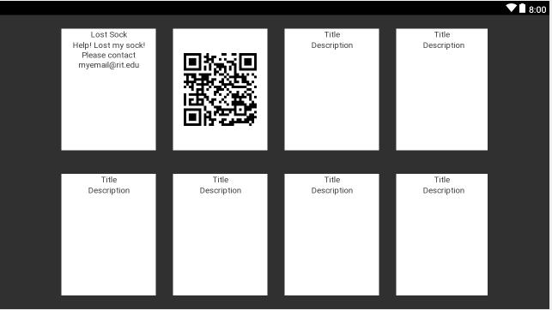
What It Does
Registration of Smart TVs in an organization
Information is displayed on registered TVs around the organization
Content can be added or removed from the TV via the web application
End users may view content on the boards and navigate to external pages
Can request content be pushed to the smart TV
Notes:
The system allows users to register smart tvs that are placed around the organization.
These registered smart tvs are then used to display content to people walking by via tiles
Content is managed via an external web application
End users ( people walking by) can view the content and navigate to external pages
End users may also request to push content they want displayed on the smart tv
Get a zoomed in picture of one of these tiles

Slide 7
Requirements and Architecture
Notes:
Stay at the most high level

Slide 8
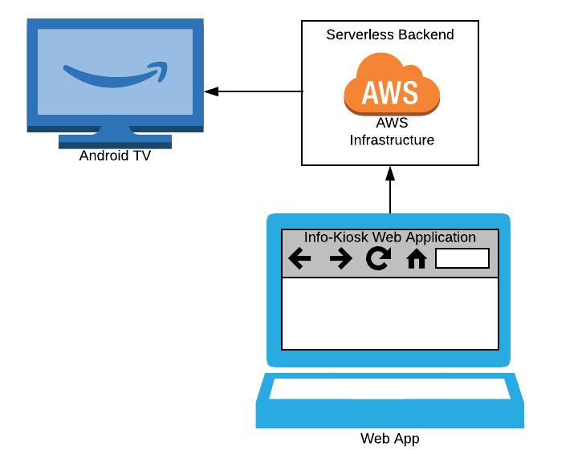


Architecture Divided into Three Sections
Web Application | Infrastructure | Smart TV Application
Behind each layer is its own separate architecture
The web application is built with the angular web framework
The Infrastructure utilizes amazon cloud services
The smart tv application operates on android tv
Built with Android SDK
High-Level Architecture
Notes:
I’ll be talking about the high level requirements and architecture of our system and how they both drive each other.
Earlier Dan threw around pieces of the architecture and spoke on how they communicated.
You all probably got an image of what the architecture looks like but for those that haven’t,
it is broken into 3 distinct sections, the web application, the infrastructure and the smart tv application.
Each of these pieces came together based on the sponsor requirements collected.
AWS Cloud infrastructure to satisfy the serverless backend
Android Tv as the IoT device to push content to
Angular Web Application that pushes the content
The specificity of the architecture will be touched on later in the slides.

Slide 9
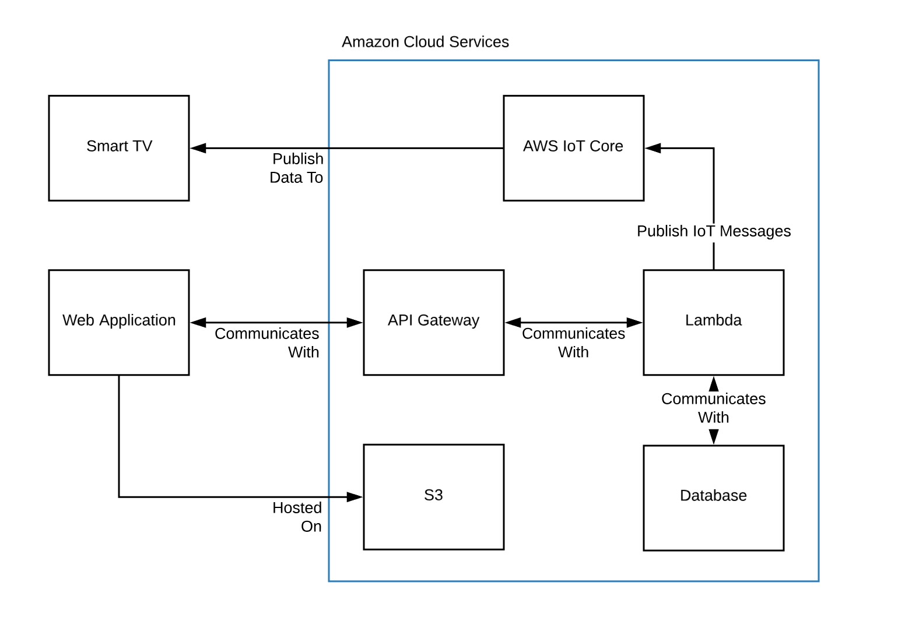
Notes:
This is a High level visual overview of the info kiosk system. As described in the previous slide
Mental use here

Slide 10
Key Requirements
Smart Tv:
Smart Tv app will have a button to submit a TV registration request
The Smart Tv app displays content in the form of cards in a tile-like layout
Each card face contains a title and a short description as well as a QR code
Web App:
Handles registration of a smart tv device
Create and push content to a smart tv device
Notes:
We have a living requirements document and we decided to emphasise the ones listed here.
We wanted to grab the key requirements that kind of describes the key behaviour of our system and highlight them.
As the user looks at the smart tv, they should immediately be presented with a tile like layout
with content describing the title and description, as well as a QR code
Grab key requirements for tv, application behavior. Web app has to be organized client/section admin
talk about they have to submit a registration request from tv and user has to submit content
Supposed to be a list of list of feature type requirements

Slide 11
Scope
In scope:
Smart Tv App should have a button to send a registration request
Web App registering a Smart Tv
Web App creating and pushing content to the smart tv
Smart Tv App displaying the content in a tile
Out of scope:
Notifications through sms/email when a content request has been approved
QR code generation and display
Notes:
Here are some of the requirements that we concluded would be in scope and out of scope.
We came about this decision through factors involving discussions with our sponsor for what needed to be in the mvp
As well due to the risks we’ve identified the learning of unfamiliar tools

Slide 12
Process Methodologies

Slide 13
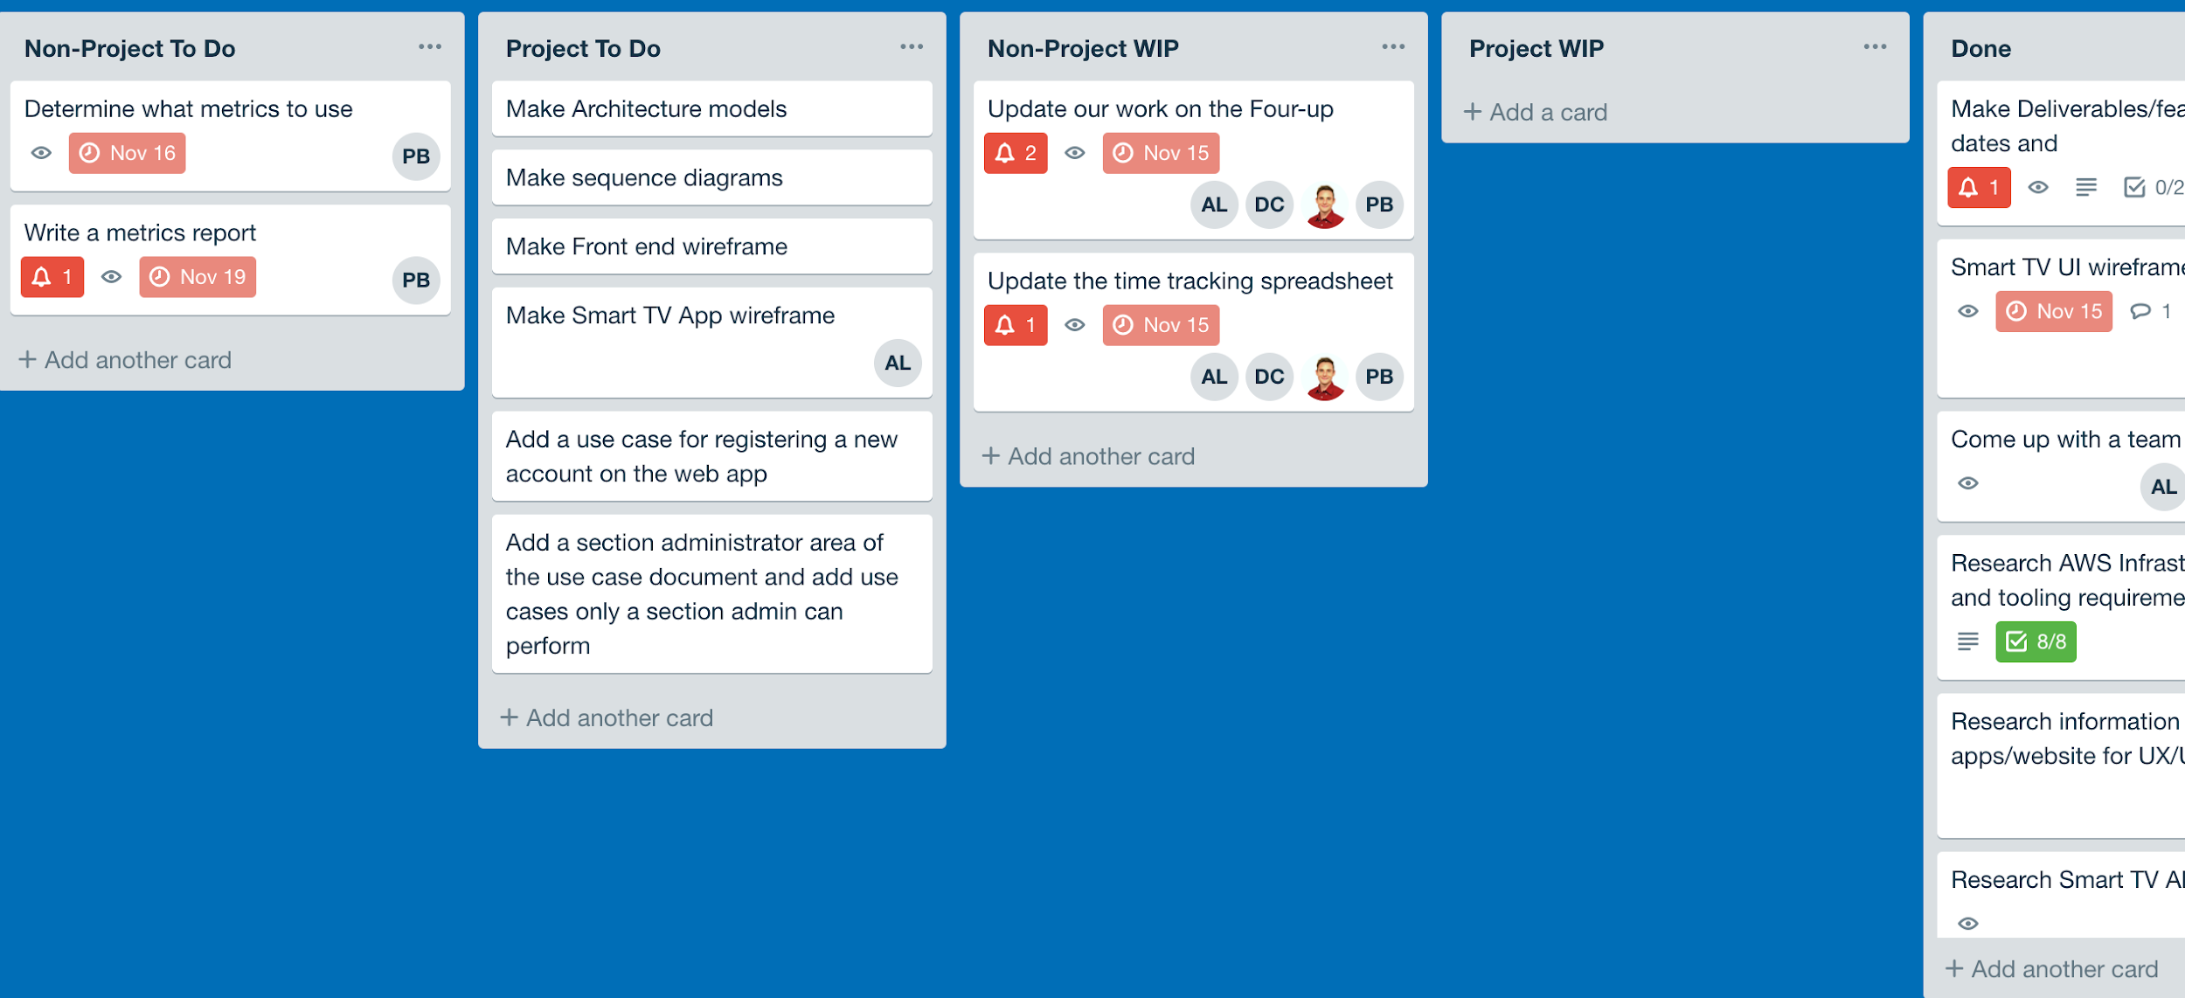
Process Methodologies
Kanban
Started with Trello boards to manage project work
Over time moved to Github Projects
Moved Back to Trello
Notes:
Started out with this.
It’s not a full process. One method used in a large process. Which process were we using? Decided to use it to manage flow of work.
We intended to ….
Followed this using …
But we encounted … we’ll discuss in lessons learned
Followed a modified scrum/kanban, whatever we call it.

Slide 14
Plan Development Steps
Gathered a list of features that needed to be developed
Derived a list of tasks from this list
Made estimates on when those features could be delivered
Organized these tasks and features into separate sprints

Slide 15
Client Interaction
Met routinely with Bizcloud nearly every Thursday
If not, rescheduled, often to Fridays
Occasionally met on Tuesdays to check in and gain approval before “official” meeting
Emails sent to request review
Consulted them about AWS architecture

Slide 16
Plan

Slide 17
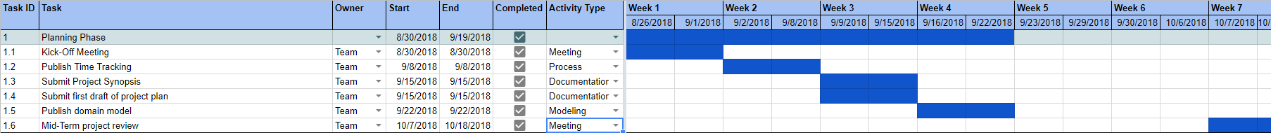
Schedule Evolution
Initially worked off of Four-Up charts and Course Website We knew what we had to get done, we just didn’t have any strict deadlines and did not have clear-cut, longer-term goals recorded
Created a Google Sheet schedule to track when items are due as well as time allotted to work on them
Created sprint plans with due dates for specific tasks

Slide 18
Schedule Term 1
Planning Phase - 9/19/18
Project plan, Synopsis, Domain Model
Design Phase - 10/17/18
Requirements, Use Cases, Sequence Diagrams, Modeling
Sprint 1 - 10/31/18
SmartTV Research, Webapp skeleton, AWS tools, Mockups
Sprint 2 - 11/14/18
API Endpoint functionality, Update Use Cases, DB schema, revisits
Sprint 3 - 11/29/18
Write Lambdas, Connect API, set up IOT, connect SmartTV
Notes:
A feature is an end to end.

Slide 19
Current Progress
Currently in mid-Sprint 3
Ultimate goal was to be able to push one Content Tile to one Smart TV
Currently much of the framework is built, but components are unconnected
Sprint ends on 11/29; Unlikely all goals will be achieved for this sprint

Slide 20
Metrics and Measurements

Slide 21
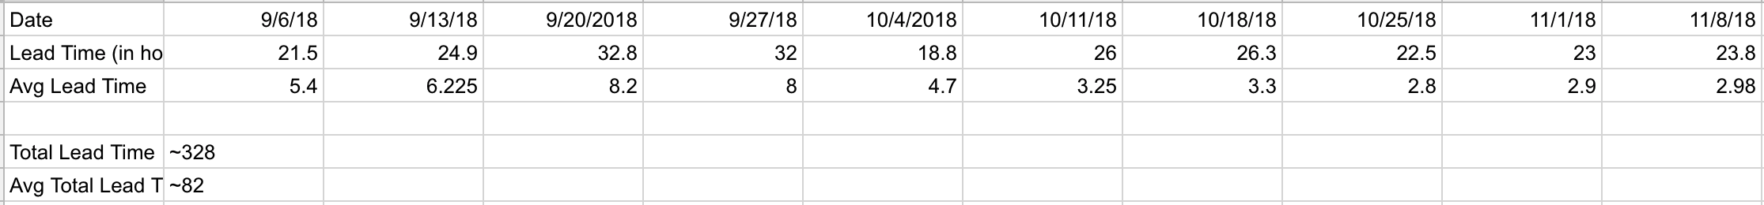
Metrics
Effort/time
The amount of time spent on all tasks over an interval
Lead time
How long it takes to finish a feature or deliverable starting from the time you actually sit down to start working on it to when you finish it
Allows us to keep track of how many hours were spent on every task
Allows us to predict if future sprints will be manageable
Notes:
One metric you should have is effort time tracking.
Replace code churn with EFFORT
Effort time is numbers you can stand behind
Key for next semester: Lock in metrics. Make sure you can measure them and measure em consistently

Slide 22
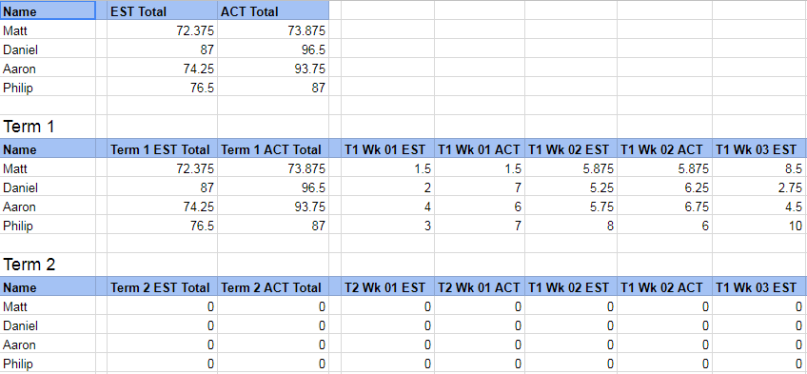
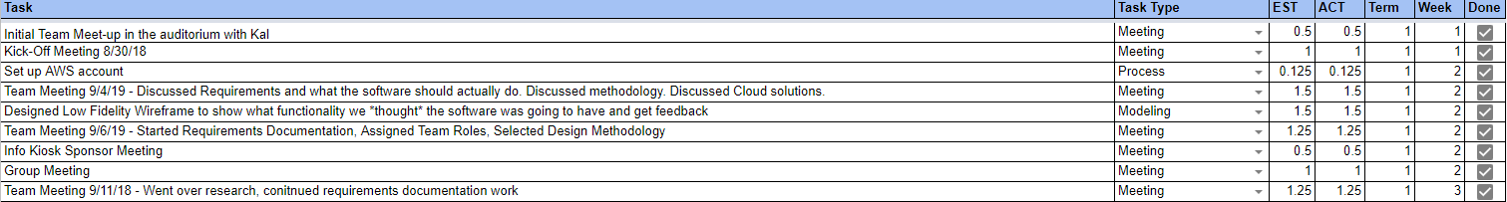
Time Tracking
Original time tracking template was built for windows, local access This was substituted for a Google Sheets adaptation
Notes:
VERY IMPORTANT

Slide 23
Risks

Slide 24
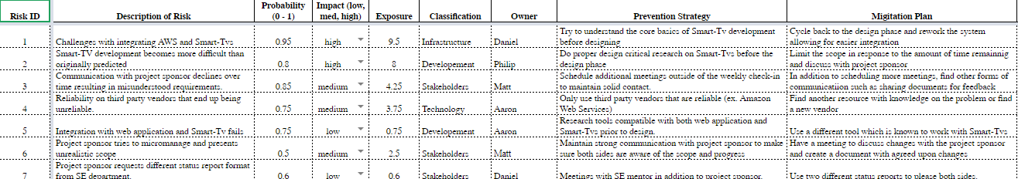
Project Risks
Living Risk Exposure Table & Four-up Charts
Lack of team based AWS knowledge
CloudFormation Scripts
User Permissions
No Smart TV App development experience
No experience with IoT
High time spent on design
Notes:
Risk exposure table.
Summarize it down.
Risk table with the risks, exposure calc, indicator and mitigation.

Slide 25
Design Choices and Constraints

Slide 26
Critical Design Choices
Smart TV Platform
Web Framework
Database Technology
Security
Cloud Infrastructure

Slide 27
Smart TV Platform
Selected: Android TV
Pros
Familiar UI
Multi-platform
Java
Cons
Alienates iPhone users
Android development learning curve
Considered:
Tizen OS
WebOS
tvOS
FireTV OS
Roku
React Native Cross platform
Notes:
researched alot of different smart tv platforms
Wanted something familiar
Weighed pros and cons
Ultimately decided on Android TV
Familiar ui and development environment
Even though it may alienate iphone users its used by multiple brands and can thus reach more users

Slide 28
Web Framework
Angular5
BizCloud Experts’ developers are already familiar with this framework
A couple of our team members are familiar with it
Path of least resistance for both
Other choices
ReactJS
Vue
Notes:
Came to a quick decision on Angular5
Wanted by bizcloud and our team
best decision that would allow use our own knowledge our sponsors expertise

Slide 29
Database Selection
Considered AWS DynamoDB
Selected MySQL Relational Database hosted on AWS RDS
Customer Suggestion
Notes:
For the database we selected a MYSQL database hosted on AWS RDS
We previously considered the non relational database Dynamo db because of previous use
But after proposing it to the sponsor they strongly suggested we use A mysql on rds

Slide 30
Security
Authorized smart tv registration
Restrict access by client id
User Authentication
Use of AWS Cognito
Database Security
Use of AWS Bastion Host
Notes:
UR could hijack and rit smart tv
One of out major security decisions is to restrict registration access by client id, this was to avoid malicious attackers registering devices to an account
Without this restriction a ur user could hijack a rit smart tv if they were just able to register by the tvs mac address
For user authentication and Database security, we had design constraints by the sponsor to use cognito and bastion host respectivly,
Cognito is basically a built in user authentication service that allows for sign up sign in and access control
Bastion host is a server that acts as a security layer between the public and and our private database stored on rds

Slide 31
Client Approved Architecture
AWS Lambda
AWS S3
AWS IOT
AWS RDS
Android TV
Angular5
Notes:
Lambda
Web app API backend and inter-cloud communication
S3
Static Website Hosting
IOT
Allows us to subscribe tvs to receive updates via a MQTT protocol
RDS
SQL server
Android TV
Angular5

Slide 32
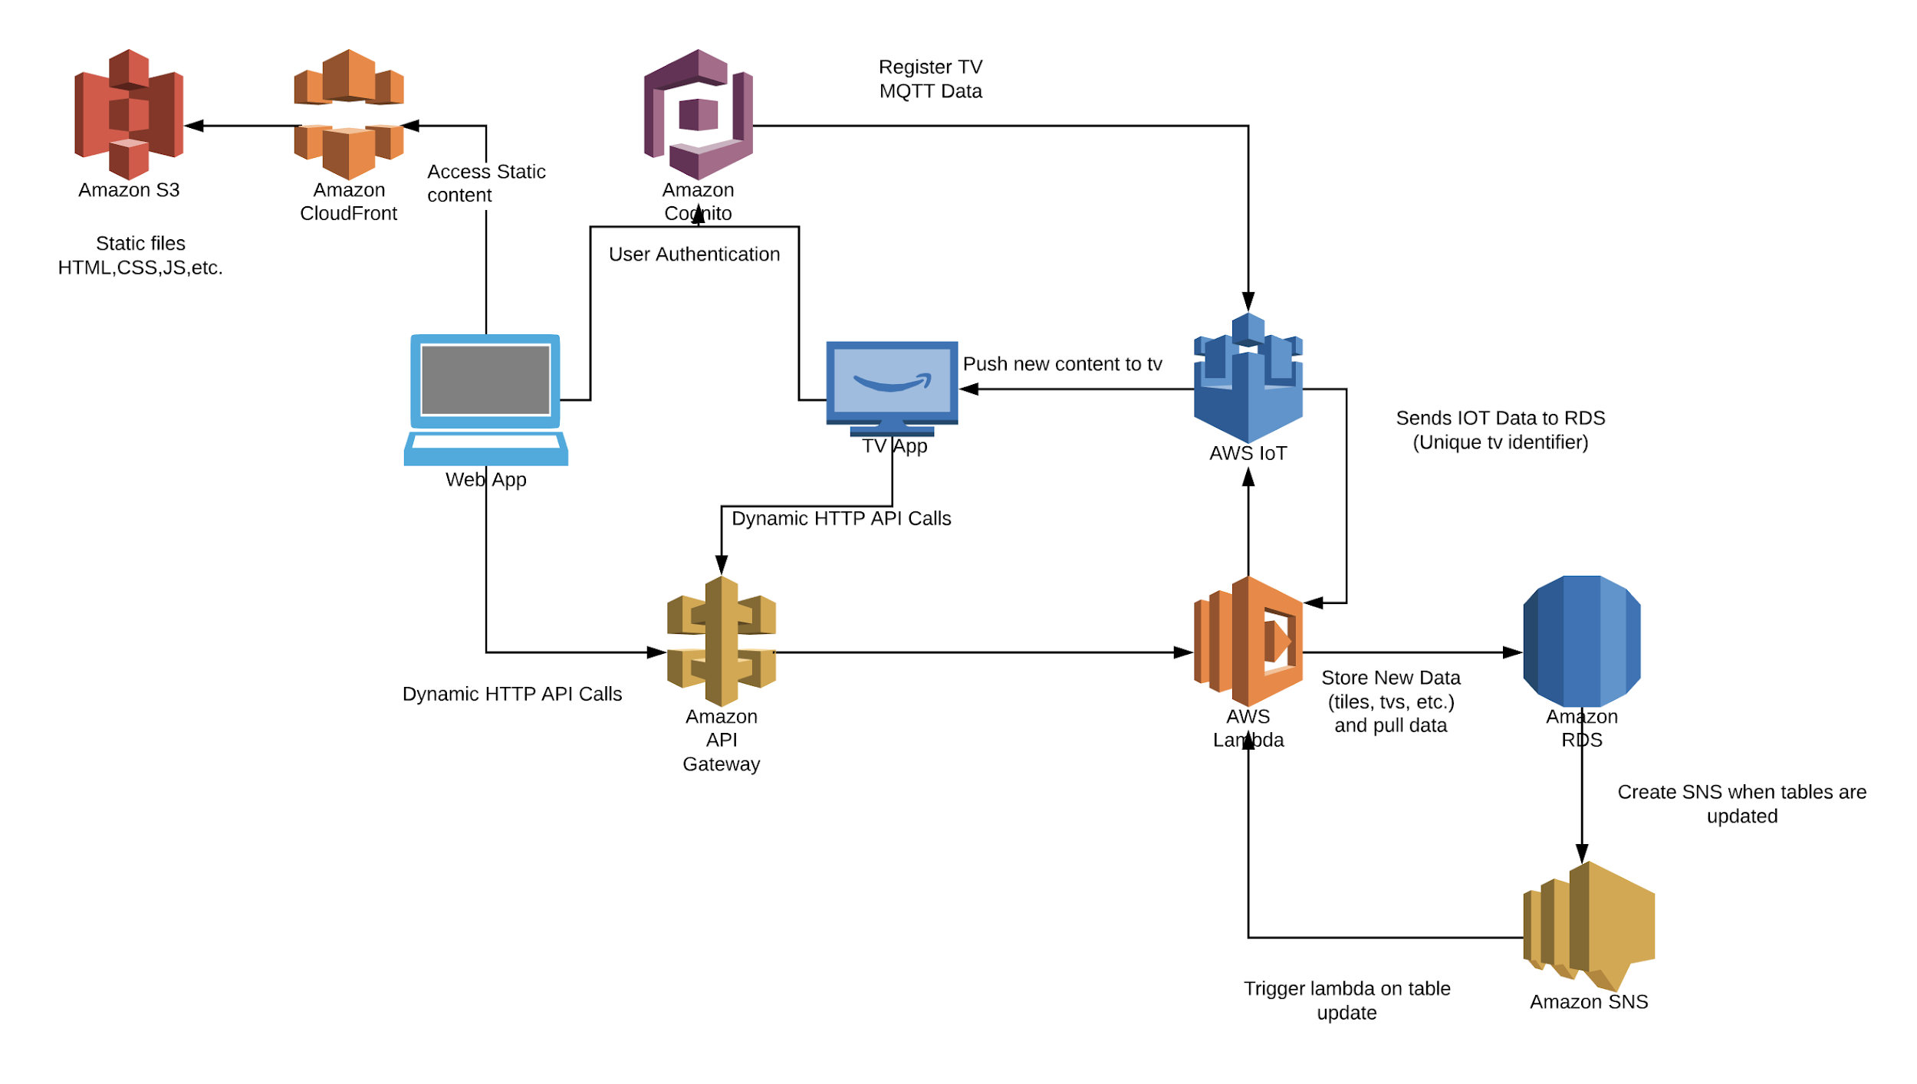

Slide 33
Lessons Learned and Future Plans

Slide 34
Lessons Learned
Issues faced:
Not following process strictly
Need to improve integrated project management
Organization/communication as a group
Team roles were not always followed
Hectic schedules without overlap
Notes:
Not following process strictly:
What that meant was that we defined a process but as the weeks carried on, we fell off and there was a lack of organization
Integrated project management was not the best:
Each piece of the architecture was worked on separately and there was a lack of execution on putting them together
We faced communication issues as a group outside of team meetings which brought up confusion on what the big picture of the product looked like

Slide 35
Plans for addressing these:
Changing the process
Stand up
Code review, Feedback block
Live integration sessions
Develop test plan and include it into process and schedule
Notes:
ScrumBan and delegating one person to manage the process
More frequent progress updates to create awareness of work done in each component of the application
Designated blocks of meetings to hold the each member accountable and create transparency of what each member produced,

Slide 36
Questions

